Slide 1

MOBILE SIGNAL REPEATER

Slide 2

Introduction
MOBILE SIGNAL REPEATERS:
Mobile signal repeaters are devices that amplify weak cellular signals to improve mobile connectivity.
Signal enhanced by the repeaters.
It is more wider when connected to mobile.

Slide 3
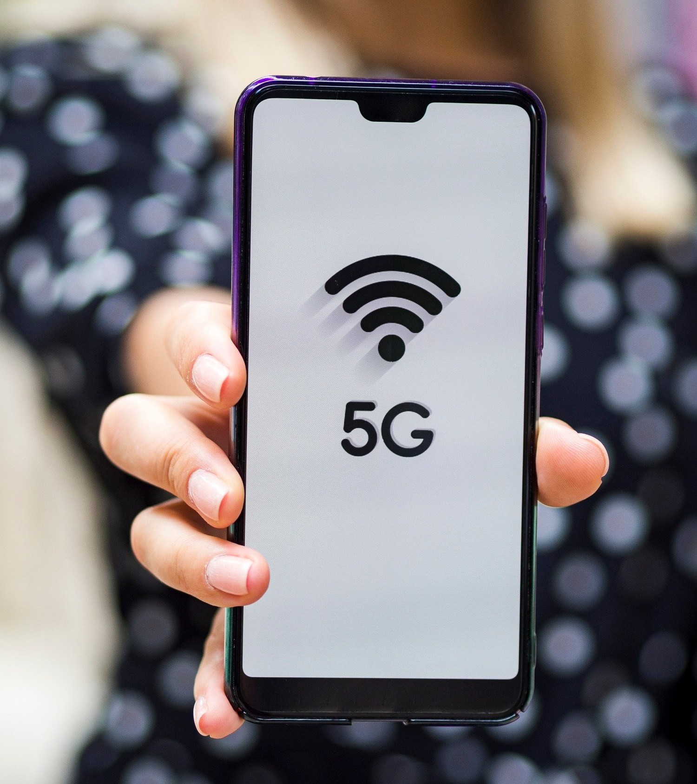
Components of Mobile Signal
Repeaters
Mobile signal repeaters are devices that boost weak cellular signals.
They consist of three main components: an outdoor antenna, an ampliﬁer, and an indoor antenna.
The outdoor antenna captures the weak signal, which is then ampliﬁed by the ampliﬁer.
Finally, the indoor antenna broadcasts the ampliﬁed signal, providing improved mobile connectivity indoors.

Slide 4

Beneﬁts of Mobile Signal Repeaters
Firstly, they eliminate dead zones by amplifying weak signals in areas with poor coverage.
Secondly, they improve call quality and data transfer speeds, ensuring a seamless mobile experience.
Lastly, signal repeaters extend battery life as mobile devices consume less power when connected to stronger signals.

Slide 5
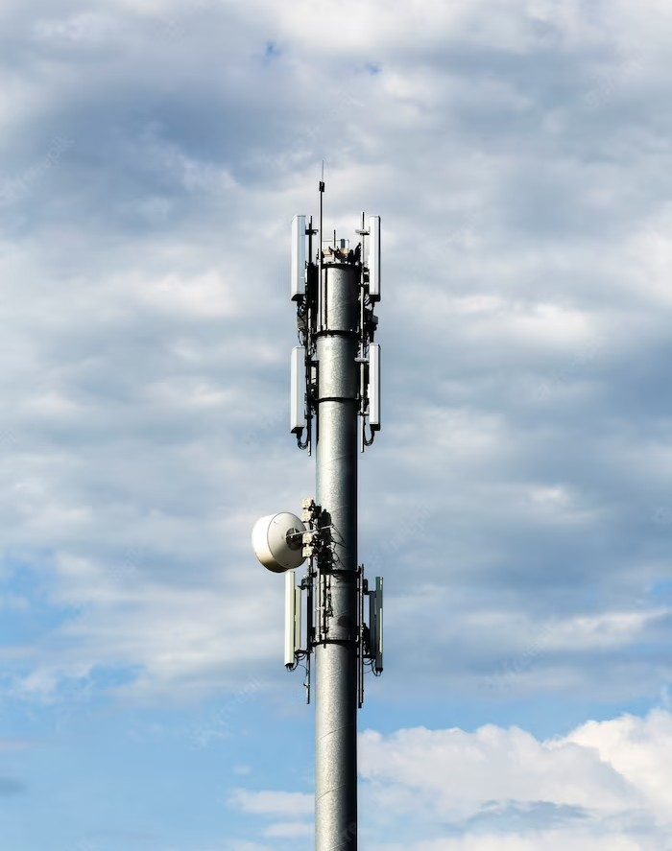
Types of Mobile Signal Repeaters
There are different types of mobile signal repeaters available. Analog repeaters amplify signals across all cellular bands, while smart repeaters intelligently amplify speciﬁc
frequencies for targeted coverage.
Additionally, dual-band repeaters support multiple frequency bands, providing enhanced
compatibility with various mobile networks.

Slide 6

Installation and Setup
Installing a mobile signal repeater is a straightforward process. It involves mounting the outdoor antenna in a suitable location, connecting it to the ampliﬁer, and placing the indoor antenna at an optimal position.
The repeater can be easily conﬁgured using the provided instructions. It's important to follow the installation guidelines to ensure optimal performance.

Slide 7

Factors Affecting Signal Repeater
Performance
Signal strength at the outdoor antenna, obstructions such as buildings or trees, and interference from other electronic devices can all affect the repeater's effectiveness.
Proper antenna placement and minimizing obstructions are crucial for maximizing the repeater's
performance.

Slide 8

Future Trends: Advancements in
Mobile Connectivity
The future of mobile connectivity looks promising. Advancements such as 5G technology and small cell networks are expected to revolutionize mobile communication.
Signal repeaters will continue to play a vital role in extending coverage and improving signal quality, ensuring seamless connectivity in an increasingly connected world.

Slide 9
Conclusion
Mobile signal repeaters are powerful tools for enhancing mobile connectivity.
They eliminate dead zones, improve call quality and data transfer speeds, and extend battery life.
Understanding the types of repeaters, installation process, and legal considerations is crucial for successful deployment.
As we move towards a future of advanced mobile technologies, signal repeaters will remain essential for ensuring reliable and seamless mobile communication.

Slide 10
Thanks!

